Slide 1





Thynk Unlimited
AI_BUGHUNTER
www.reallygreatsite.com

Slide 2


Thynk Unlimited
Supervisor's Name: Dr.Wael Farouk Elsersy
Abdelrhman Elshazly Zaky : 224657
Hossam Abdelrheem Soltan : 224527
02

Slide 3

Thynk Unlimited
Introduction
-Security vulnerabilities in software systems pose a significant threat, often leading to financial losses and reputational damage. Traditional security tools struggle to keep pace with modern codebases, especially in C and C++, which are flexible but prone to vulnerabilities. To address this, we propose AIbughunter—a machine learning-based tool designed to detect, classify, and repair vulnerabilities in real-time.
-AIbughunter utilizes advanced machine learning to effectively identify vulnerabilities in code, helping developers proactively mitigate security risks. The project is actively being developed for continuous improvement and expanded capabilities.
03

Slide 4
Thynk Unlimited
BACKGROUND
AIbughunter is an advanced ML-powered tool designed to detect and classify vulnerabilities in complex C/C++ code , addressing the limitations of traditional tools that struggle with high false positives and slow adaptation to new threats. By integrating Graph Neural Networks (GNNs), AIbughunter enhances accuracy and embeds security seamlessly into the developer’s workflow, providing proactive, in-line vulnerability detection that evolves alongside modern coding challenges.
04

Slide 5

Thynk Unlimited
Find bugs automatically: Use AI to catch bugs faster and more accurately.
MOTIVATION
Make software better: Reduce mistakes and create more reliable software.
Help developers focus: Let developers work on harder tasks by handling bug detection for them.
05

Slide 6

Thynk Unlimited
OBJECTIVES
Study the existing Vulnerability dectection systems, and its limitations
Propose a new enhancement to the most recent vulnerability detection system using new methodologies
Evaluating the new mythology using the relevant evaluation metrics
Deploy the enhanced system to VS-Code
Benchmarking the final results with the latest systems
06

Slide 7
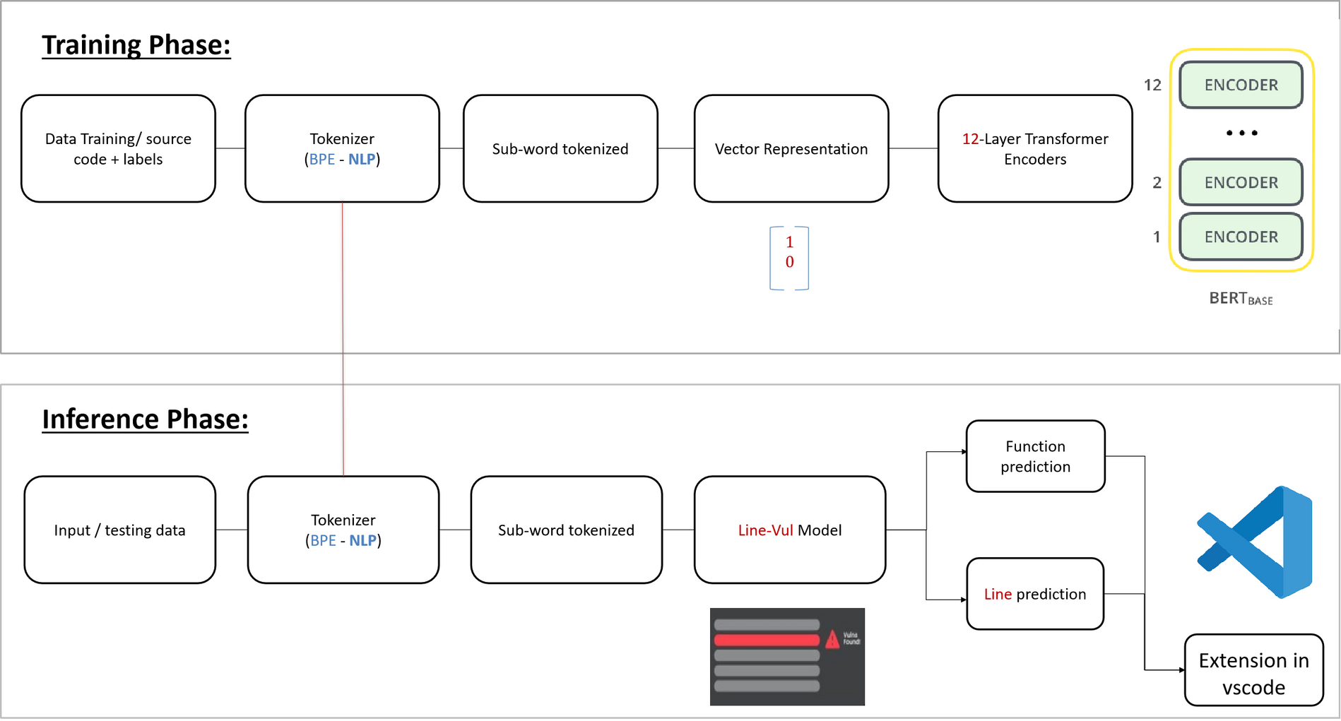
Thynk Unlimited
07

Slide 8
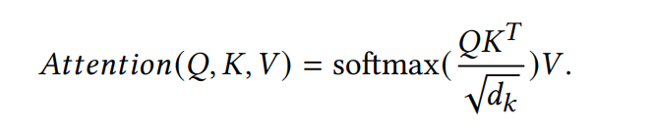
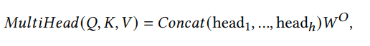
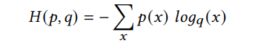
Self-Attention Calculation: The self-attention layer computes attention scores using matrix multiplication. The formula for calculating attention.
Thynk Unlimited
Q (Query), K (Key), and V (Value) matrices represent different transformations of the input.
dkd_kdk​ is a scaling factor, equal to the dimension of the keys, which prevents overly large values in the softmax function and ensures stable gradients.
Transformer-based Architecture:
Q (Query), K (Key), and V (Value) matrices represent different transformations of the input.
Dk is a scaling factor, equal to the dimension of the keys, which prevents overly large values in the SoftMax function and ensures stable gradients.
Loss Function: Cross-Entropy Loss:
Cross-Entropy Loss is used as the objective function to update model weights during training. The cross-entropy loss is given
where p is the ground-truth distribution, and q is the predicted probability distribution.
08

Slide 9
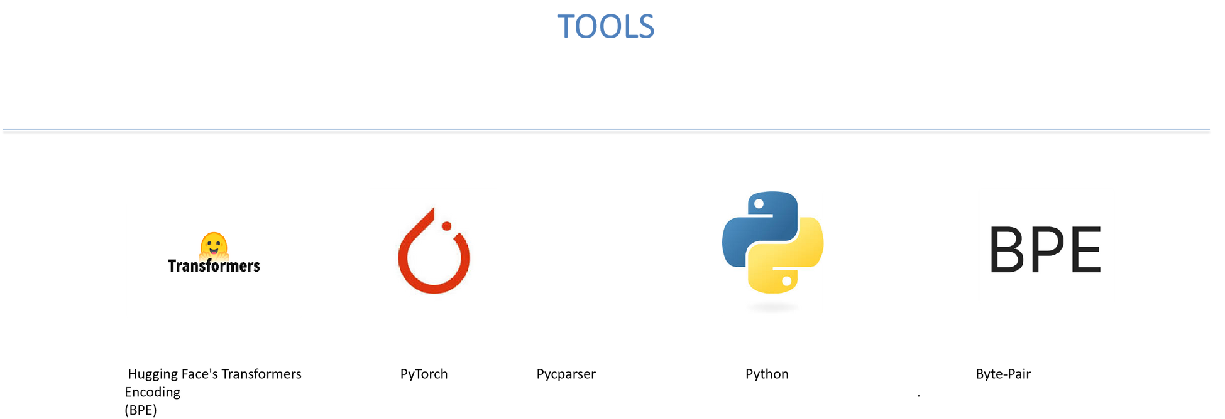
Thynk Unlimited
09

Slide 10
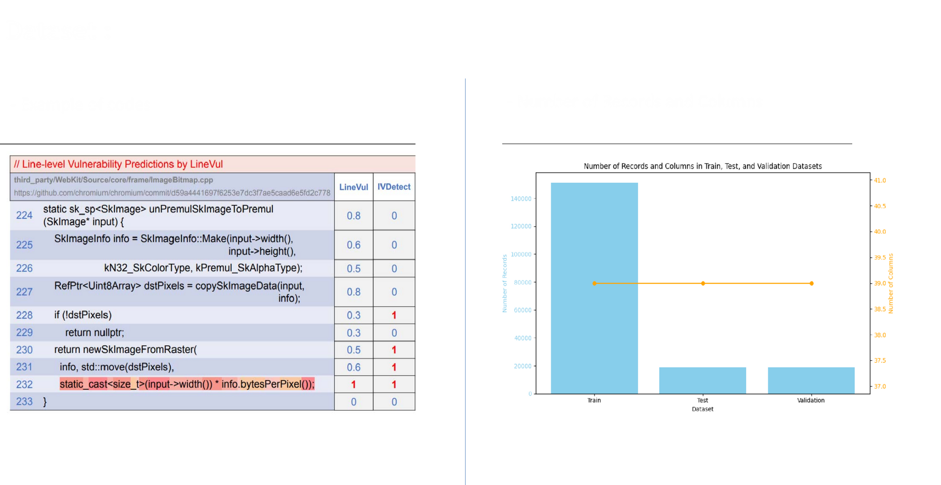
www.reallygreatsite.com
Thynk Unlimited
10

Slide 11
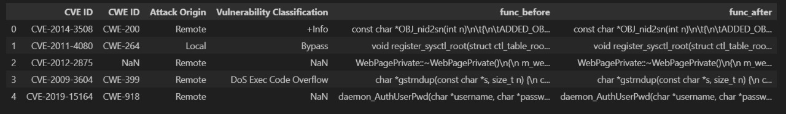
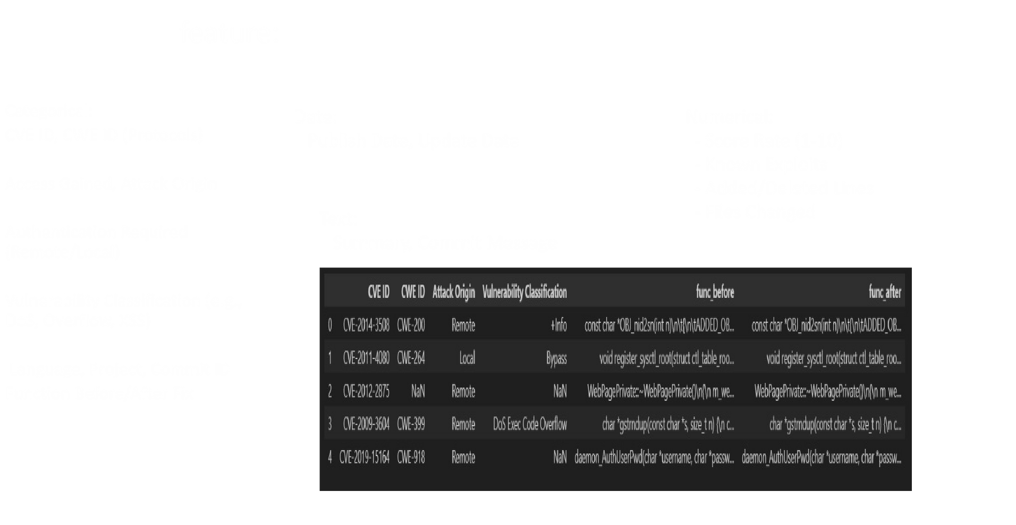
Thynk Unlimited
Features
Categorical:
CVE ID, CWE ID (Protocols)
Access Gained, Attack Origin
Authentication Required (Remote/Local)
Vulnerability Classification (e.g., DoS, Overflow, XSS)
Language, Project, Commit ID
Function Before/After Fix
Date:
Publish Date, Update Date
Text:
Summary, Commit Message
Numerical:
- Score Rate (1-10)
- Known Exploits
- Added/Deleted Lines
- Files Changed
11

Slide 12
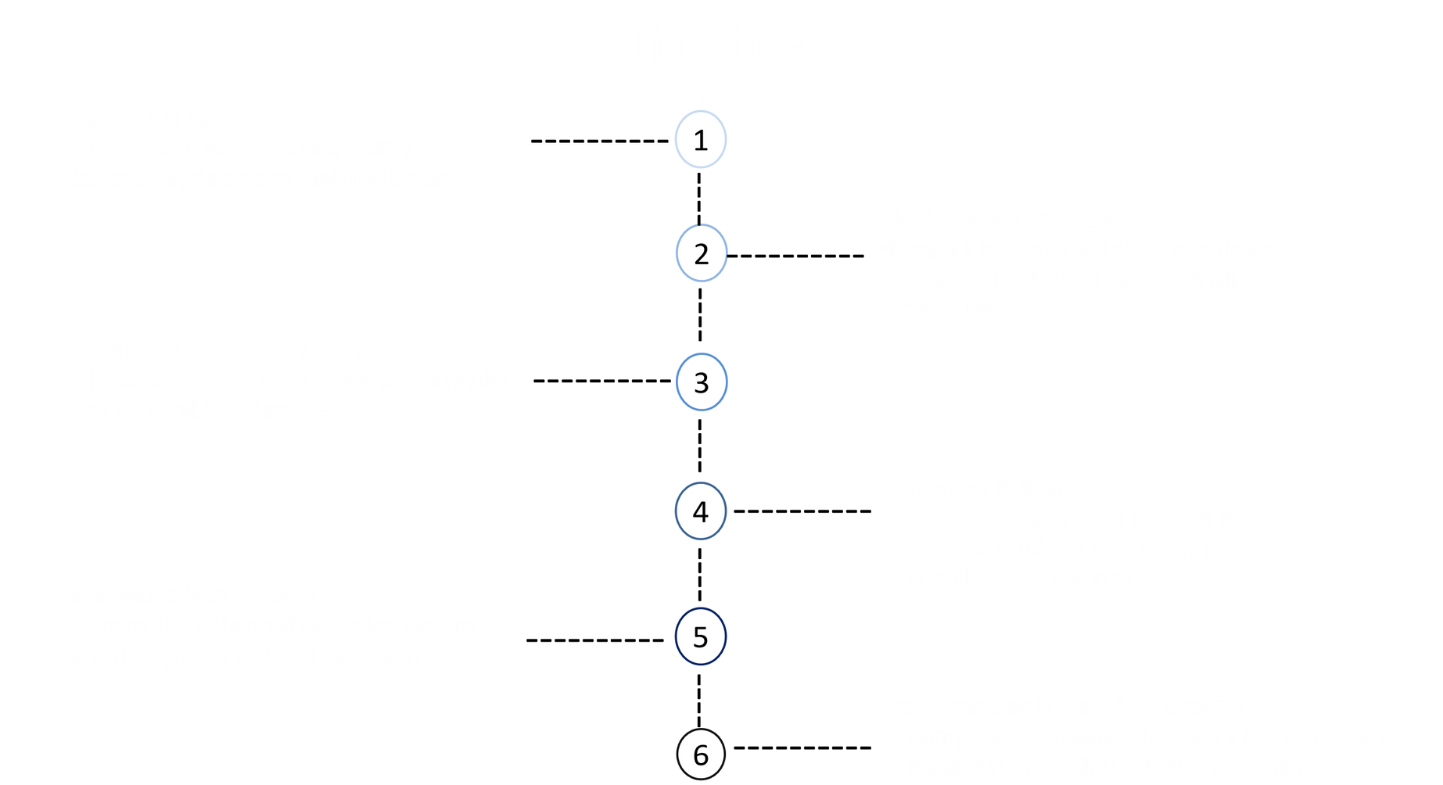
12

Slide 13
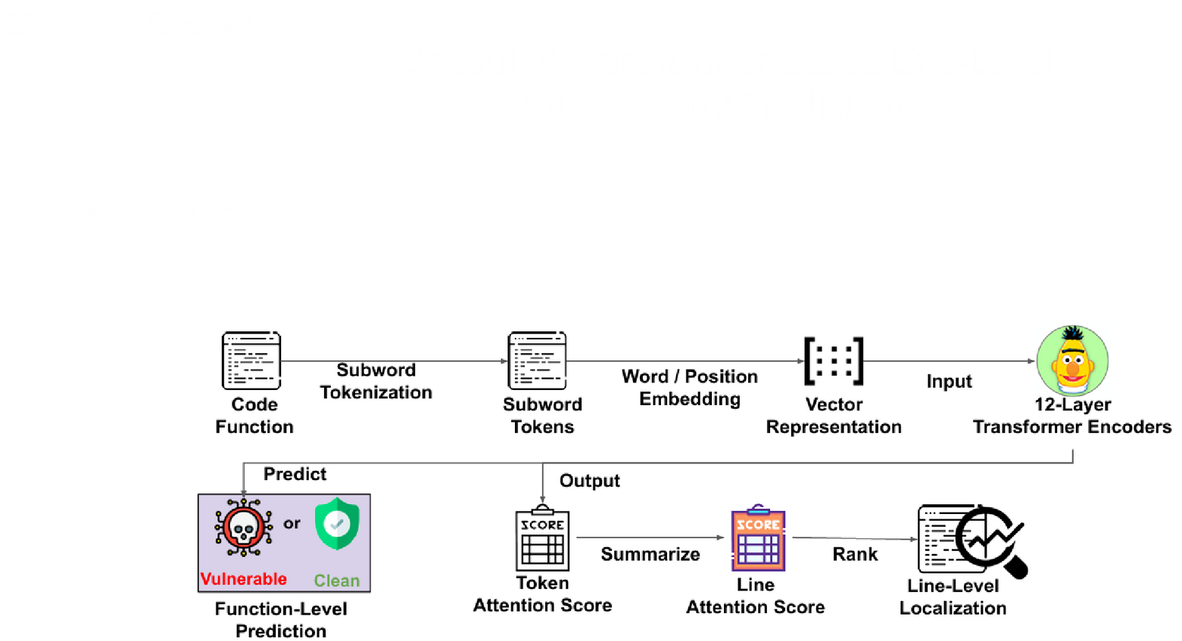
Thynk Unlimited
13

Slide 14
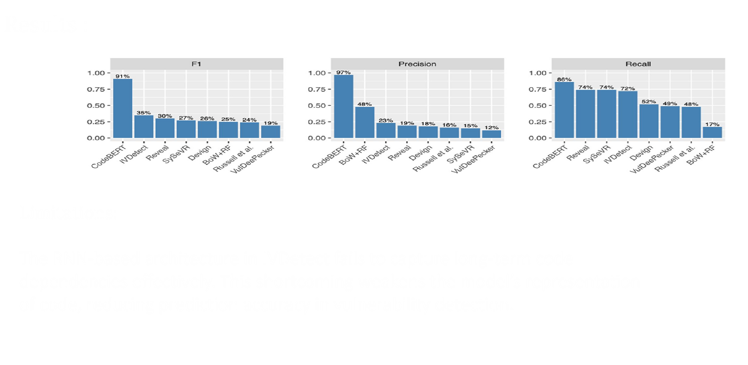
Thynk Unlimited
14

Slide 15
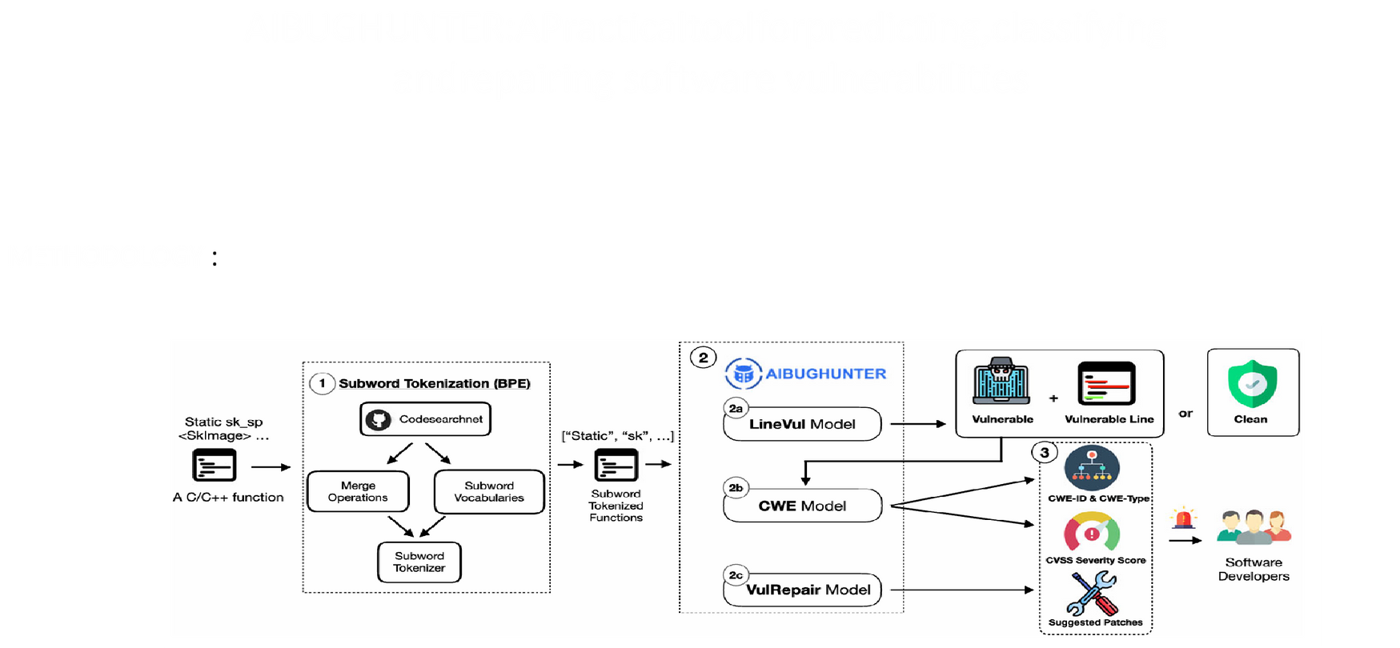
Thynk Unlimited
15

Slide 16
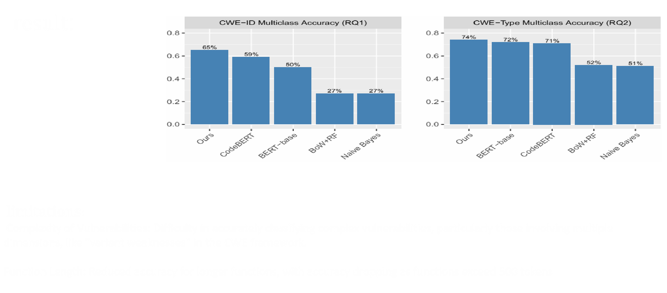
Thynk Unlimited
16

Slide 17
Thynk Unlimited
Conclusion
AIbughunter is a powerful tool that elevates software security by using advanced machine learning to detect and classify vulnerabilities in C/C++ code in real-time. By addressing the limitations of traditional tools, it provides developers with accurate, proactive vulnerability detection, seamlessly integrated into their workflows. This approach not only improves security but also enhances productivity by allowing developers to focus on complex tasks. As it evolves, AIbughunter promises to be an essential asset for secure coding practices, keeping pace with modern cybersecurity demands.
17

Slide 18
Thynk Unlimited
Fu, M., & Tantithamthavorn, C. (2022). LineVul: A Transformer-based Line-Level Vulnerability Prediction. In Proceedings of the 19th International Conference on Mining Software Repositories (MSR '22), May 23–24, 2022, Pittsburgh, PA, USA. ACM, New York, NY, USA, 13 pages. https://michaelfu1998-create.github.io/papers/linevul.pdf
REFERENCES
Fu, M., Tantithamthavorn, C., Le, T., Kume, Y., Nguyen, V., Phung, D., & Grundy, J. (2024). Aibughunter: A practical tool for predicting, classifying and repairing software vulnerabilities. Empirical Software Engineering, 29(1), 4. https://link.springer.com/content/pdf/10.1007/s10664-023-10346-3.pdf
18

Slide 19
Fu, M., & Tantithamthavorn, C. (2022). LineVul: A Transformer-based Line-Level Vulnerability Prediction. In Proceedings of the 19th International Conference on Mining Software Repositories (MSR '22), May 23–24, 2022, Pittsburgh, PA, USA. ACM, New York, NY, USA, 13 pages. https://michaelfu1998-create.github.io/papers/linevul.pdf
Fu, M., Tantithamthavorn, C., Le, T., Kume, Y., Nguyen, V., Phung, D., & Grundy, J. (2024). Aibughunter: A practical tool for predicting, classifying and repairing software vulnerabilities. Empirical Software Engineering, 29(1), 4. https://link.springer.com/content/pdf/10.1007/s10664-023-10346-3.pdf
Thynk Unlimited
THANK YOU
19

